Slide 1
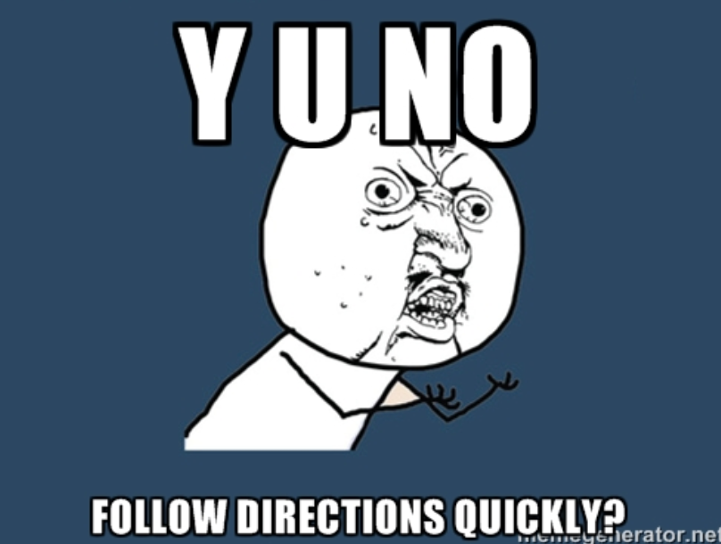
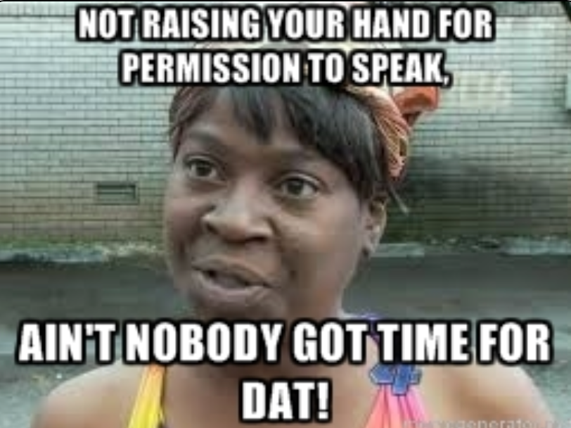
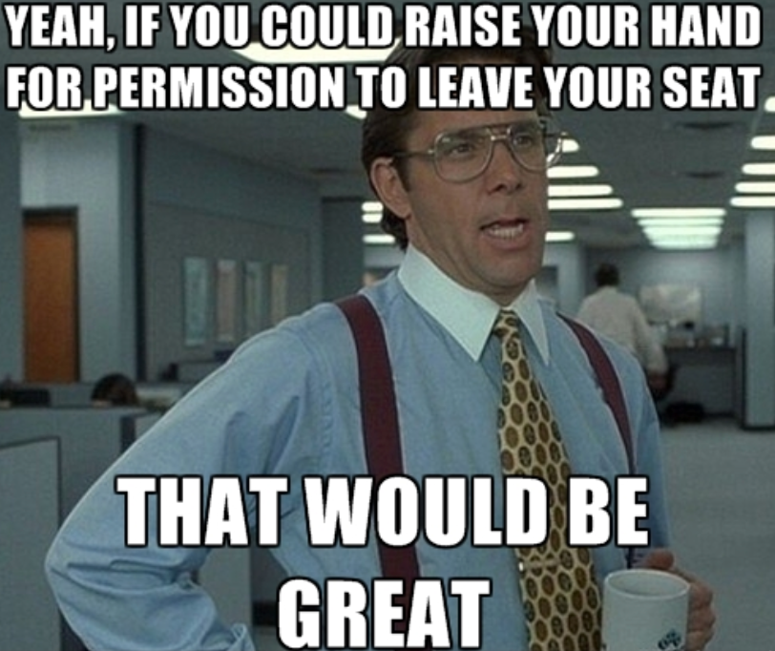
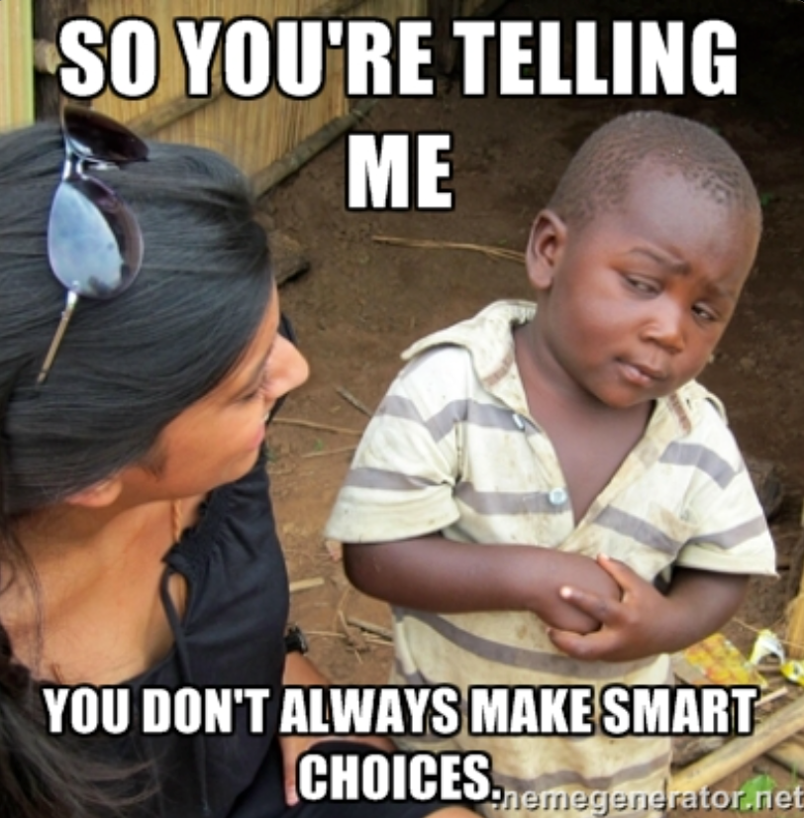
Ms. Leach Kickemuit Middle School– Purple Lightening 2016-2017 School Year
Social Studies
Helpful Class Reminders:
1. Follow directions
quickly.
2. Raise your hand
for permission to
speak.
3. Raise your hand
for permission to
leave your seat,
or wait for
appropriate time.
4. Make smart
choices.
5. Keep your dear
teacher HAPPY.
Class Expectations
Be on time for class.
Be prepared to work.
Treat everyone and their property with respect.
Keep you work neat and organized.
Work quietly.
Be an active listener.
Follow the school rules.
“There is a difference between not knowing and not knowing YET.”
-- Shelia Tobias
Course Description
Welcome to 7th grade Social Studies! Our focus this school year will be learning and developing our skills as critical thinkers, readers, writers, speakers, and listeners, as we travel through different periods in history. We will be exploring the Fall of the Roman Empire, the Middle Ages, and the Renaissance.
What do I get if I follow class rules?
Your appropriate behavior in class assures everyone of an environment conducive to learning. Some possible rewards for continuous appropriate behavior are positive note to parents, purple lightening tokens, and special class activities / privileges.
What are the consequences if I don’t follow class rules?
** An email or phone call will be made home**
1. Warning: I will provide a non-verbal warning, first. If you continue the disruptive behavior, you will receive a verbal warning.
2. Lunch Detention: Time spent during lunch to reflect on behavior.
3. After School Detention: You will receive an after school detention to discuss behavior with teacher, and reflect.
4. Referral to Administration: You will be immediately referred to
administration regarding the distruptive behavior.
Where do I go to find agendas and assignments?
Google Classroom is our class website. This site will house assignment due dates, PDF copies of class handouts, important announcements, and more.
Weebly is the team webpage. I will use this tool to help remind you of important due dates and announcements, as well as post the daily classwork and homework. Please bookmark the following site and check it daily.
Website: http://purplelightning7.weebly.com/
Where do I go for extra help?
I will be available after school for extra help. My schedule will be posted on the class calendar, weekly. Please notify me during class that you will be staying after.
Email: chelsea.leach@bwrsd.org phone & ext: 401.253.2048

Slide 2
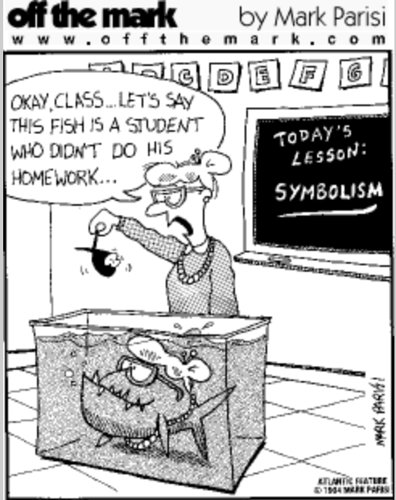
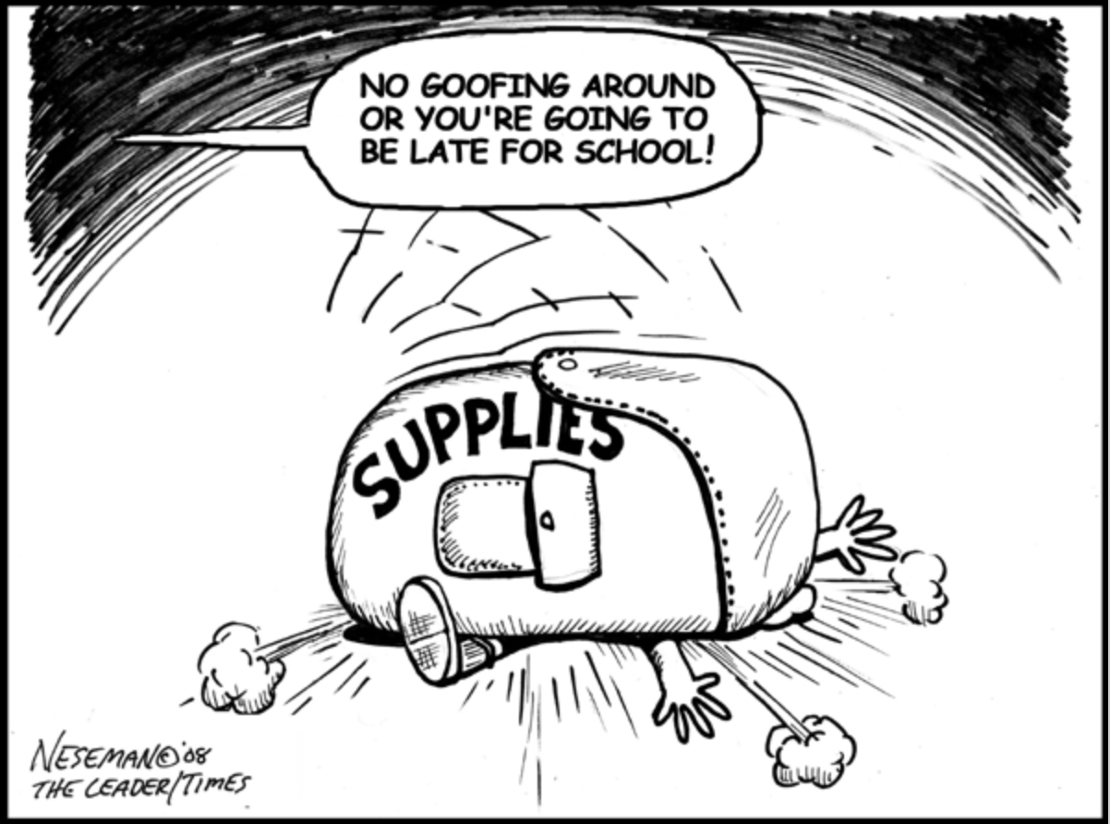
Topics
What happens if I turn in an assignment late?
The Early Middle Ages
The Rise of Cities and Towns
The Role of Religions and Catholic Church
The Rise of Monarchies
The Feudal Society
The Black Death
The Renaissance
The Reformation
Work not completed and turned in by the assigned date is considered late. If a student is absent on the date work is due, the assignment is due the first day the student returns to school. COMPLETED LATE WORK will only receive partial credit (70% of the assignment total). UNIFINISHED WORK will result in a grade of a zero.
If you forgot an assignment, you must fill out a “Pink Slip” and return to teacher.
How will I check my grade in class?
Parents and students are strongly encouraged to check the ASPEN Parent Portal on a weekly basis to view the most current grades for EVERY class.
What do I do if I am absent?
Always check the class Edmodo site for agendas, handouts, and assignment due dates. A student has two extra days to turn in any work assigned on a day a student was absent. If a quiz was administered on a day a student was absent, the quiz must be made up on the first day the student returns. If previously assigned work was due on the day of the absence, the work is due on the first day the student returns otherwise it is considered late and will only receive partial credit.
Grade Breakdown
Common Assessments / Tests= 40%
Quizzes = 25%
Classwork = 25%
Homework (Practice) = 10%
If a group member is absent, you are responsible for filling out a “While You Were Out” report. In this report, you will include the missed handouts and agenda, for your group member.
What types of activities and assignments will I do this year?
Daily Warm Ups & Exit Tickets
Station Tasks
Partner Activities
Individual Work
Small Teams/Group Work
Assessments, such as quizzes or tests
Projects
Technology-Based Activities
Primary/Secondary Source Analysis
Interpreting maps and other graphics
Bring to Class:
What types of skills will we be focusing on?
One notebook, supplied by KMS
Silent Reading Book, “ORB”
Pencils
Pens
Highlighters
If you forget your supplies, please ask for permission to return to your locker at the beginning of class. Do not wait until the middle of the period!!
Thinking sequentially
Note-taking
Identifying the author’s main idea
Summarizing primary and secondary sources
Creating a claim, and supporting the claim with evidence
Planning and organizing constructed responses
Critical and analytical historic thinking

Slide 3
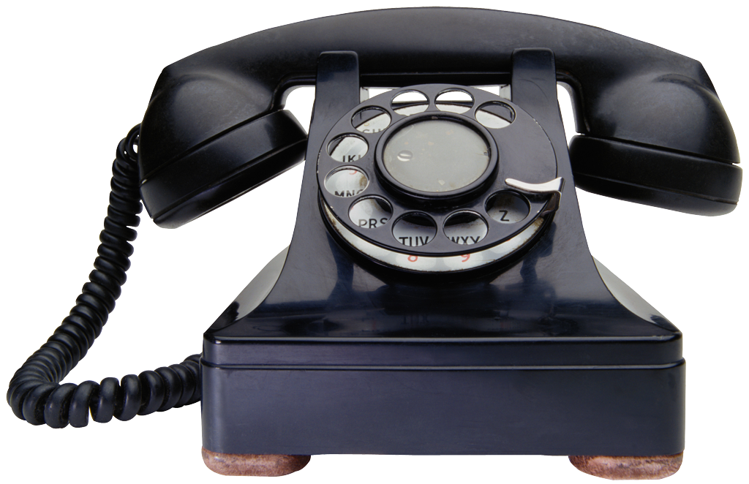
Please read the course information, sign, and return this sheet to Ms Leach.
Students:
Please sign below to signify that you have read the course sheet for Ms Leach’s class, will keep it in your binder, and will be responsible for the information throughout the year, and will check ASPEN Parent Portal regularly at home or at school.
_______________________________________ _______________________________________
Student printed name Student signature
-----------------------------------------------------------------------------------------------------------------------------------------
Parents/Guardians:
Please sign below to indicate that you have read the course sheet for Ms Leach’s class and that you will help your student be accountable for the information. If you have questions about the course or your student’s work, please do not hesitate to contact me; email is the best way to reach me quickly. See the front of the syllabus for my email address.
_____________________________________ _____________________________________
Parent/Guardian printed name Parent/Guardian signature
_____________________________________ _____________________________________
Parent/Guardian e-mail Parent/Guardian daytime phone number
(please print)
Parents and guardians, please CIRCLE the best way for me to contact you:
e-mail phone

